Slide 1
WEEK 11
MUHAMMAD NAEEM AKHTAR

Slide 2
Virtual Function
A pointer contains address of its type.
Base class pointer can point to the object of any of its descendent class
But the converse of above is false.
Dynamic binding
Example of Car Inheritance and calculate area.
See virutal1.cpp

Slide 3
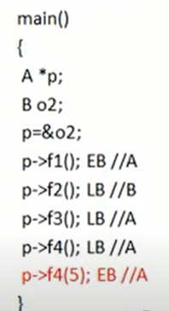
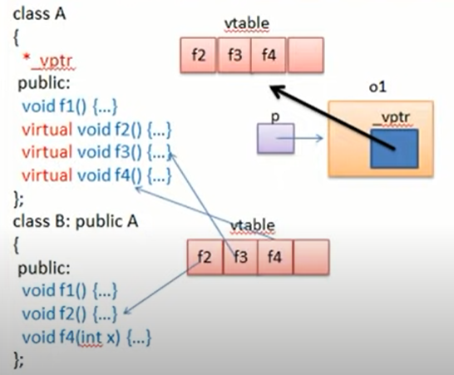
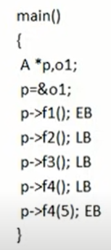
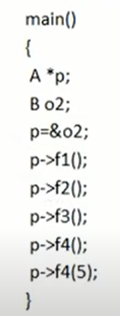
How virtual function works
Notes:
What if
B b;
p=&b;
Create Table.

Slide 5
Abstract Class
A class having at least one pure virtual function.
Why no object of abstract class?
We don’t want to call pure virtual function.
But we can still access pure virtual function using child class?
Solution: Override is must
Why virtual function??
To stop early binding.
See example: Abstract1.cpp

Slide 6
Why we need Abstract Class?
Let us have two classes Student and Faculty.
Both have some common attributes and functions.
To generalize, we make Person class containing common features of both.
We are interested in storing information of student or faculty but not Person.
We don’t want to create object of Person class.

Slide 7
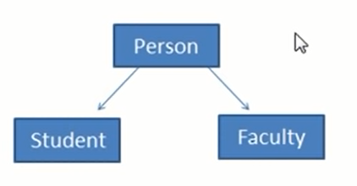

Slide 8
Virtual Destructor
Deleting a derived class object using a pointer of base class type that has a non-virtual destructor results in undefined behavior. To correct this situation, the base class should be defined with a virtual destructor. For example, following program results in undefined behavior.
A virtual destructor is used to free up the memory space allocated by the derived class object or instance while deleting instances of the derived class using a base class pointer object.
A base or parent class destructor use the virtual keyword that ensures both base class and the derived class destructor will be called at run time, but it called the derived class first and then base class to release the space occupied by both destructors.
See virtual desctructor.cpp, virtual desctructor1.cpp

Slide 9
Why we use virtual destructor in C++?
When an object in the class goes out of scope or the execution of the main() function is about to end, a destructor is automatically called into the program to free up the space occupied by the class' destructor function.
When a pointer object of the base class is deleted that points to the derived class, only the parent class destructor is called due to the early bind by the compiler.
In this way, it skips calling the derived class' destructor, which leads to memory leaks issue in the program. And when we use virtual keyword preceded by the destructor tilde (~) sign inside the base class, it guarantees that first the derived class' destructor is called.
Then the base class' destructor is called to release the space occupied by both destructors in the inheritance class.

Slide 10
Generic Programming
Generics is the idea to allow type (Integer, String, … etc and user-defined types) to be a parameter to methods, classes and interfaces. For example, classes like an array, map, etc, which can be used using generics very efficiently. We can use them for any type.
The method of Generic Programming is implemented to increase the efficiency of the code.
Generic Programming enables the programmer to write a general algorithm which will work with all data types.
It eliminates the need to create different algorithms if the data type is an integer, string or a character.

Slide 11
Generic Programming
The advantages of Generic Programming are
Code Reusability
Avoid Function Overloading
Once written it can be used for multiple times and cases.
It is implemented using templates in C++

Slide 12
Templates in C++
A template is a simple yet very powerful tool in C++.
The simple idea is to pass data type as a parameter so that we don’t need to write the same code for different data types.
For example, a software company may need to sort() for different data types.
Rather than writing and maintaining multiple codes, we can write one sort() and pass data type as a parameter.
C++ adds two new keywords to support templates: ‘template’ and ‘typename’.
The second keyword can always be replaced by the keyword ‘class’.

Slide 13
Templates in C++
A template is a simple yet very powerful tool in C++.
The simple idea is to pass data type as a parameter so that we don’t need to write the same code for different data types.
For example, a software company may need to sort() for different data types.
Rather than writing and maintaining multiple codes, we can write one sort() and pass data type as a parameter.
C++ adds two new keywords to support templates: ‘template’ and ‘typename’.
The second keyword can always be replaced by the keyword ‘class’.

Slide 14
How Templates Works?
Templates are expanded at compiler time.
This is like macros. The difference is, that the compiler does type checking before template expansion.
The idea is simple, source code contains only function/class, but compiled code may contain multiple copies of the same function/class.

Slide 15
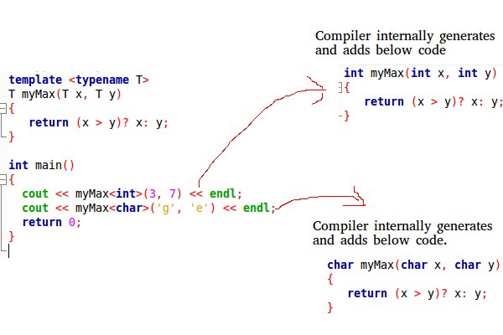

Slide 16
Function Templates
We write a generic function that can be used for different data types. Examples of function templates are sort(), max(), min(), printArray().
See example: template1.cpp, template2.cpp

Slide 17
Class Templates
like function templates, class templates are useful when a class defines something that is independent of the data type. Can be useful for classes like LinkedList, BinaryTree, Stack, Queue, Array, etc.
See template3.cpp template4.cpp

Slide 18
The C++ Standard Template Library (STL)
The Standard Template Library (STL) is a set of C++ template classes to provide common programming data structures and functions such as lists, stacks, arrays, etc.
It is a library of container classes, algorithms, and iterators.
It is a generalized library and so, its components are parameterized.
Working knowledge of template classes is a prerequisite for working with STL.

Slide 19
The C++ Standard Template Library (STL)
STL has 4 components:
Algorithms
Containers
Functions
Iterators
Details in next lecture

